Slide 1
The Internet and Its Uses

Slide 2
What is the Internet?
Definition: The Internet is a global network of interconnected computers that communicate through standardized protocols, allowing billions of devices worldwide to share information and resources.
Key Features:
Global connectivity
Decentralized network structure
24/7 accessibility
Information sharing platform

Slide 3

Learn about history of internet

Slide 4
How the Internet Works
Core Components:
Internet Service Providers (ISPs): Provide internet access
Servers: Store and serve web content
Routers: Direct data packets to destinations
Protocols: Rules for data transmission (HTTP, TCP/IP)
Domain Name System (DNS): Translates web addresses
Connection Methods:
Broadband, Fiber optic, Wireless, Mobile data

Slide 5
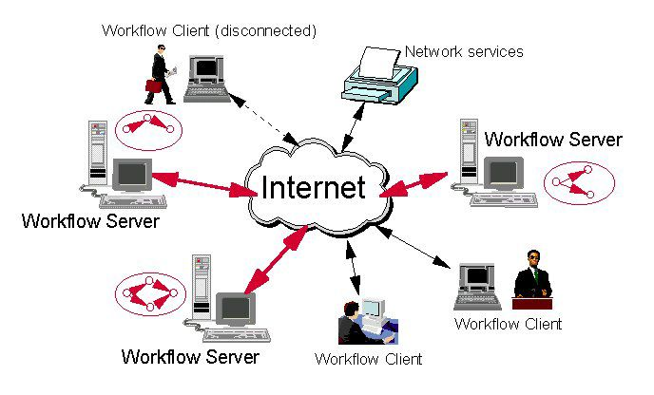
Image about how internet works

Slide 6

Audio about the internet

Slide 7
Thank You!!!

